Slide 1
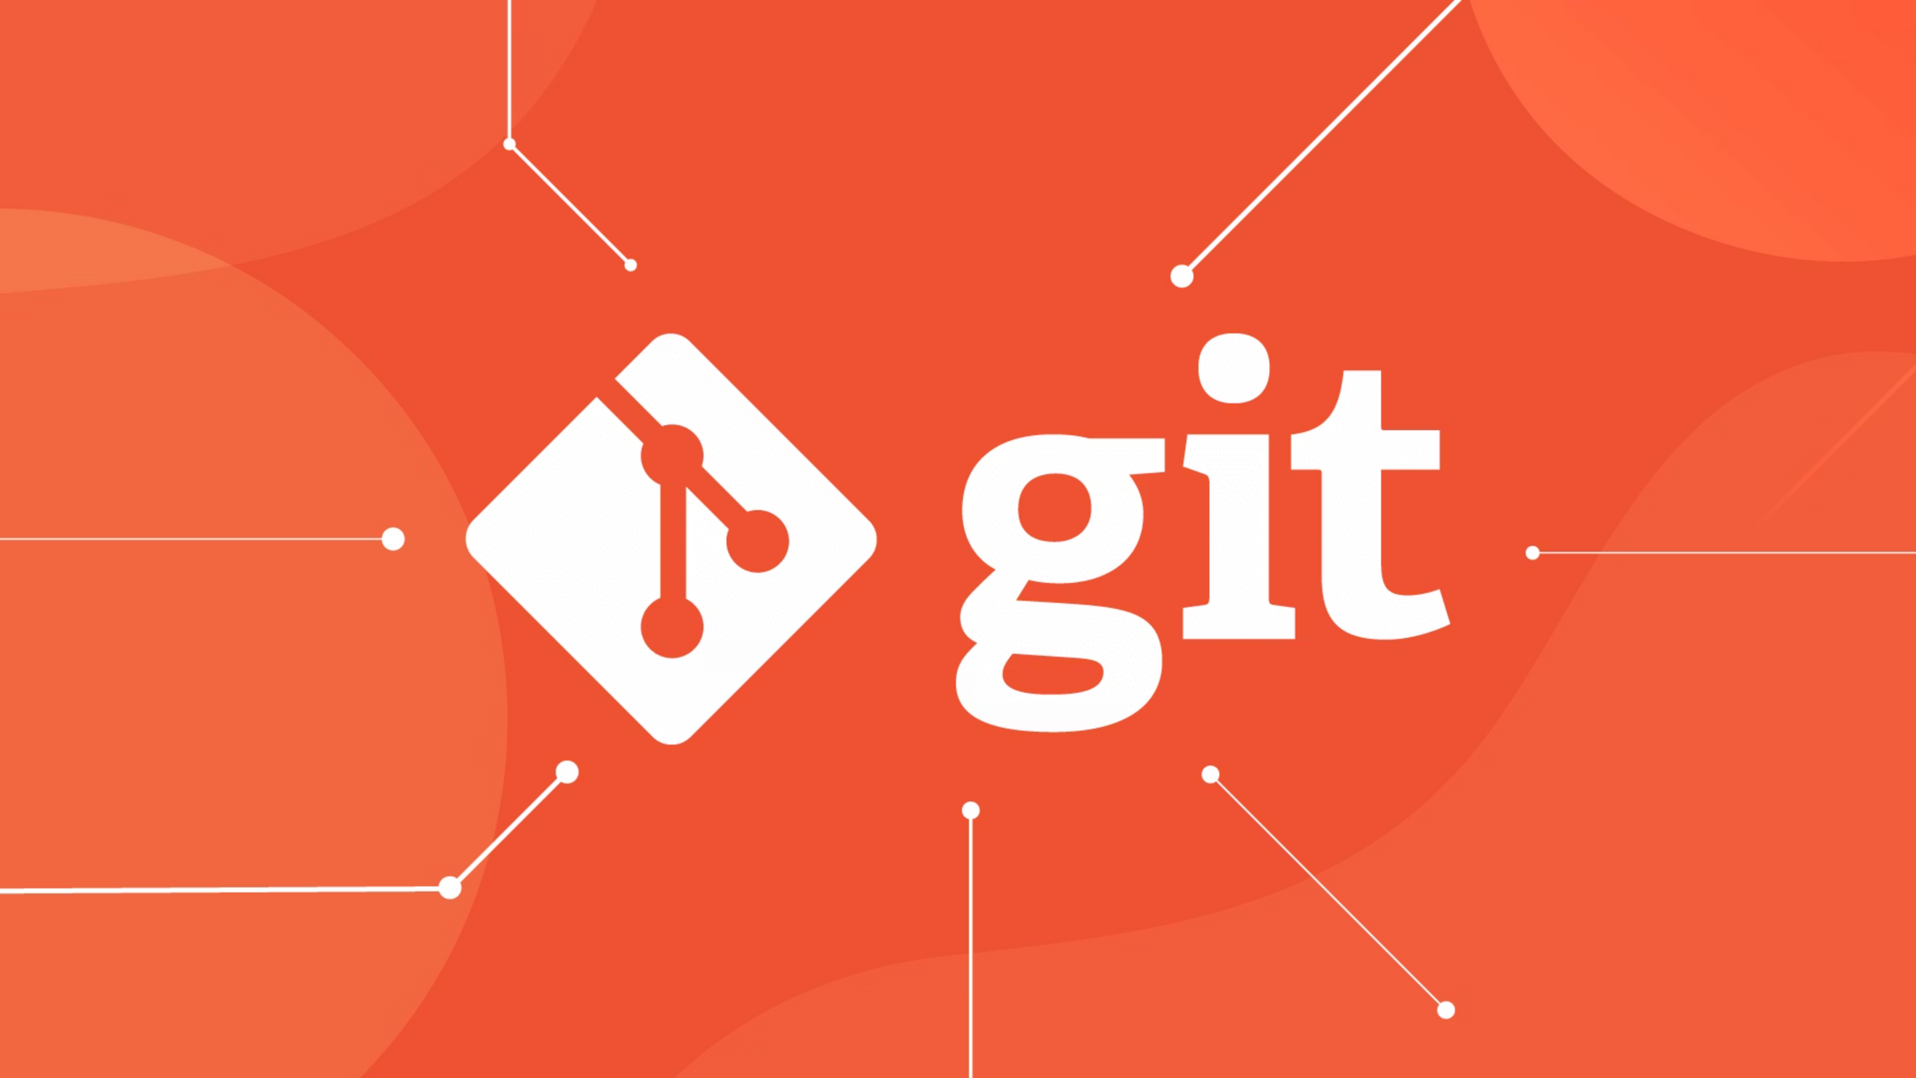

Fundamentals
Presenter
Mohammad Anees Alam
Notes:
1

Slide 2

Why Version Control Matters
Track Every Change
Know exactly who changed what code, when they changed it, and why they made those changes.
Enable Collaboration
Multiple developers can work on the same project simultaneously without stepping on each other's toes.
Backup & Recovery
Accidentally deleted important code? No problem. Revert to any earlier version in seconds.
Safe Experimentation
Test new features and ideas without breaking your main product or disrupting your team.
Notes:
2

Slide 3
Evolution of Version Control Systems
Local Version Control
1
Examples: RCS
Changes tracked only on one computer. Like keeping a personal diary—only you can see it. Limited to single-person projects with no collaboration.
2
Centralized Version Control
Examples: CVS, SVN, Perforce
One central server stores all versions. Like a library where everyone borrows from one place. Easy to manage but creates a single point of failure.
Distributed Version Control
3
Examples: Git, Mercurial
Every developer has a complete copy. Like giving everyone a full photocopy of the library—even if the main library burns down, all the books are safe.
Notes:
3

Slide 4



Why Git Dominates the Industry
Distributed Model
Ecosystem Integration
Safe, fast, and reliable. No single point of failure means your team keeps working even when servers go down.
Git seamlessly connects with GitHub, GitLab, and Bitbucket. These platforms integrate perfectly with CI/CD pipelines, making DevOps workflows smooth and automated.
Powerful Branching
That's why almost every DevOps workflow starts with Git.
Easy experimentation and seamless teamwork. Create branches instantly, merge effortlessly.
Lightning Fast
Commits, diffs, and merges happen in milliseconds, not minutes. Your workflow stays smooth.
Notes:
4

Slide 5
Git's Role in Modern Development
Git is like a time machine for your code.
Every change becomes a snapshot you can rewind, fast-forward, or branch off from.
Track Changes
Enable Safe Experiments
Merge Work Together
See exactly what changed, who changed it, and why they made the change.
Let teams try new ideas without breaking the main codebase.
Bring everyone's contributions together seamlessly with intelligent merging.
Notes:
5

Slide 6






Essential Git Concepts
Branches
Parallel Workstreams
Separate timelines for development. Like multiple chefs cooking different dishes in separate kitchens—they don't interfere with each other.
Commits
Snapshots of Changes
Like save points in a video game. Each commit captures your work at a moment in time with a unique ID, author, date, and message.
Merging
Bringing Work Together
Combining branches back into one. Like merging two different recipe versions into a single cookbook.
Notes:
6

Slide 7

Setting up GIT on your local environment, follow this:
Notes:
7

Slide 8


Repository Setup: Initialize vs Clone
Initialize New Repository
Clone Existing Repository
git init
git clone
Start a brand-new Git repository from scratch. Perfect when you're creating a new project folder.
Copy an existing remote repository (like from GitHub). Use when your team already has a repo and you want the same copy.
mkdir git-demo && cd git-demogit init
git clone https://github.com/user/repo.gitcd repo
Pro Tip: Use git status as your "health check"—it shows untracked files, staged files, and your current branch.
Notes:
8

Slide 9




The Git Workflow: Stage, Commit, Push
Make Changes
Edit files in your working directory. Like writing new chapters for your book.
Stage Changes
git add filename
Select which changes go in your next commit. Like putting specific items in your shopping cart.
Commit Changes
git commit -m "Message"
Create a permanent snapshot. Like checking out at the cashier with a receipt.
Push Changes
git push
Send your commits to the remote repository so teammates can see your work.
Notes:
9

Slide 10





Collaboration Best Practices
Write Clear Commit Messages
Commit Small, Logical Chunks
Good: "Fix login bug: incorrect password validation"
Don't commit 500 lines at once. Break changes into focused, reviewable pieces that solve specific problems.
Bad: "update"
Always Pull Before Merging
Resolve Conflicts Carefully
Get the latest changes from your team before merging to avoid unnecessary conflicts and integration issues.
When merge conflicts occur, take time to understand both changes. Don't just delete lines blindly.
Notes:
10

Slide 11

Ready to Master Git
You've Learned the Fundamentals
Next Steps
  Why version control is essential for development
  Git's core concepts: commits, branches, and merging
Do a thorough revision before coming to next session as we will be deep diving into more advanced concepts of git.
  Repository setup and basic workflow
  Collaboration best practices
Remember: Every professional developer uses Git daily. Master it, and you'll be ready for any development team.
Notes:
11

